Slide 1
ENDOMETRIAL RESEPTIVITE DEĞERLENDİRMESİ
PROF.DR.MEHMET ÇOLAKOĞLU
NEU MERAM TIP FAKULTESİ
KADIN HST VE DOĞUM AD
UREME ENDOKRINOLOJISI VE INFERTILITE BD
KONYA

Slide 2
Embryo implantasyonu için geçici olarak endometriumun uygun hale gelmesine denir.
RESEPTİVİTE TARİF

Slide 3
IMPLANTATION WINDOW
Postovulatuar 6-10 günlerde açılır, bunun dışında non-reseptiftir. Siklus boyunca optimal hazırlıkların yapıldığı devredir. External hormonlarla bu günlerde oynama yapılabilir.

Slide 4
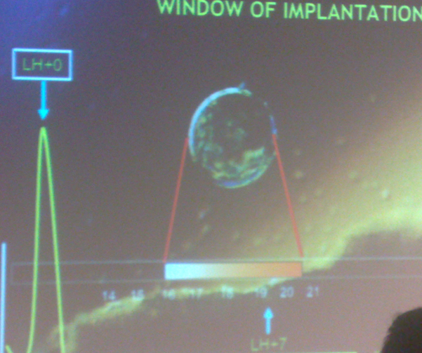

Slide 5
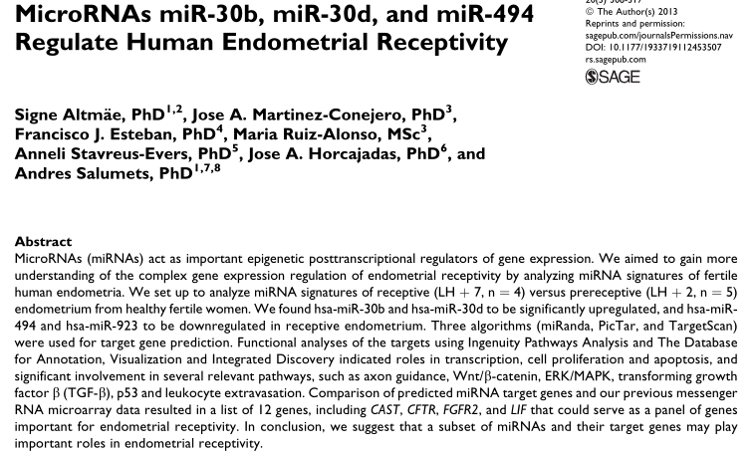

Slide 6
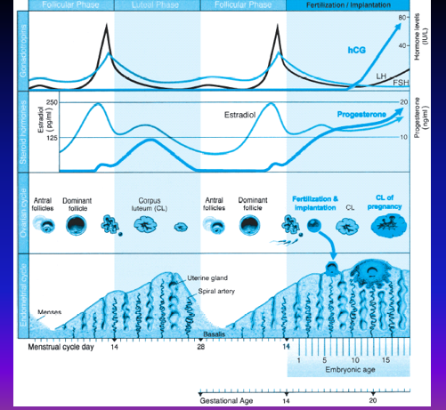

Slide 7
Implantation Process
Human embryo implantation üç aşamalı işlemdir (apposition, adhesion and invasion) functional blastocyst ile reseptive endometrium arasında olur. Bu ovarian steroid bağımlı bir olaydır.

Slide 8
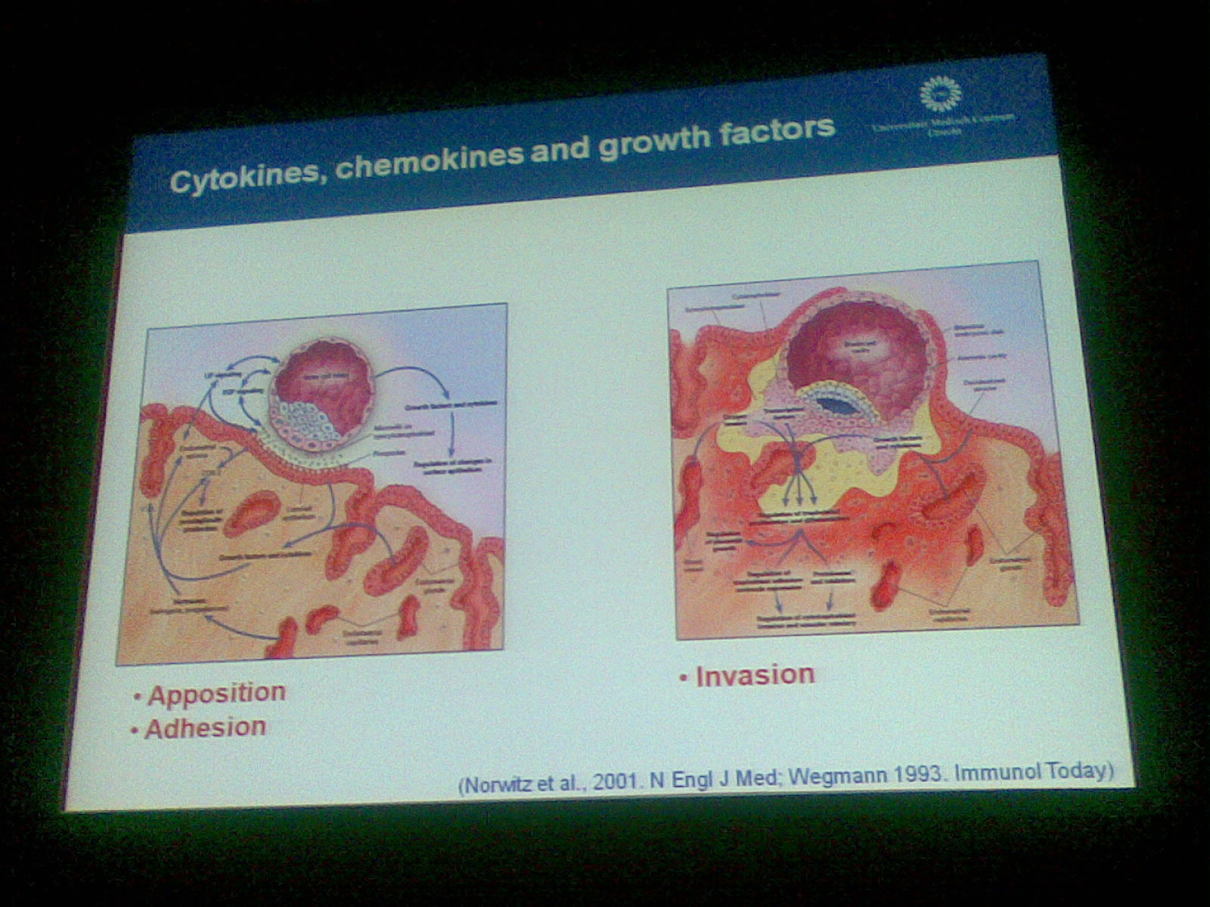

Slide 9
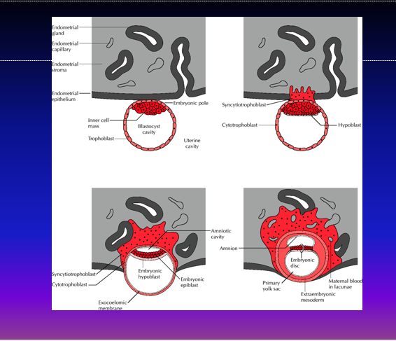

Slide 10
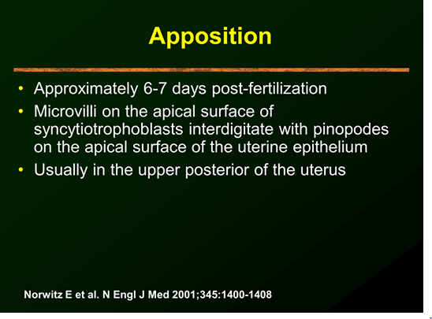

Slide 11
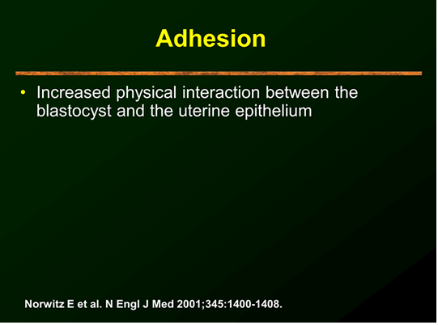

Slide 12
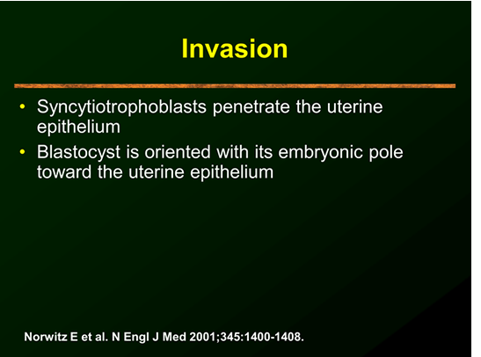

Slide 13
The selectin adhesion system is well established at the maternal–fetal interface
On the blastocyst side, strong L-selectin staining has been observed over the entire embryo surface (Genbacev et al., 2003 ). On the maternal side, the expression of selectin oligosaccharide-based ligands, such as MECA-79 or HECA-452, is up-regulated during the window of implantation (Genbacev et al., 2003 ).

Slide 14
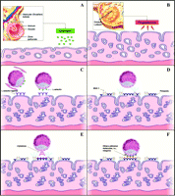
Human embryo implantation in the uterus. (A) Endometrium proliferates under estrogen enhancement. (B) Progesterone from luteinized follicles leads to endometrial differentiation. (C) The blastocyst enters the uterus through the ostia and rolls freely over the endometrium under signals by L-selectin. (D) Mucin-1 (MUC-1) repels the blastocyst and prevents its adhesion to endometrial areas with poor chances of implantation. (E) Chemokines and cytokines attract the blastocyst to the optimal implantation spot. (F) Adhesion molecules (e.g. integrins and cadherins) firmly attach the blastocyst to the endometrial pinopods to ensure further successful implantation.

Slide 15
ENDOMETRIAL STEROID RECEPTORLERİ
İmplantasyonda Estrogen ve Progesteron reseptorleri önemlidir.
Luteal fazda , progesteron glandular epitelde PR downregulasyonu yapar. PR downregulation ve pre-implantation integrin expresyonu arasında sıkı ilişki vardır.

Slide 16
ENDOMETRİAL RESEPTİVİTEYİ ETKİLEYEN GENETİK FAKTÖRLER
Hoxa 10 expressionu

Slide 17
Pinopods appear progesterone dependant. Association between mid-luteal increase of progesterone level and the first appearance of pinopods throughout the menstrual cycle was noted (Stavreus-Evers et al., 2001 ; Usadi et al., 2003 ). Moreover, HOXA-10, a homeobox gene whose expression is necessary for endometrial receptivity to blastocyst implantation, has an essential role in pinopod development. Indeed, blocking HOXA-10 expression dramatically decreases the number of pinopods. HOXA-10 illustrates a dual role in the endometrium by regulating both endometrial stromal cell (ESC) proliferation and epithelial cell morphogenesis (Bagot et al., 2001 ).

Slide 18
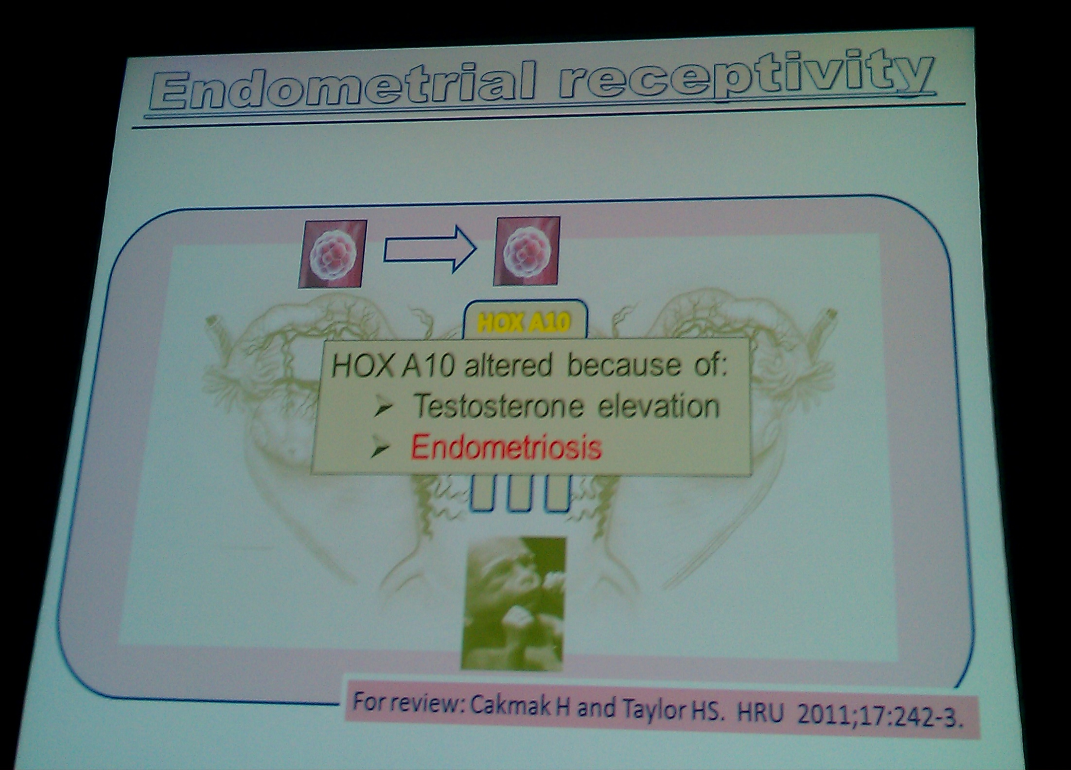

Slide 19
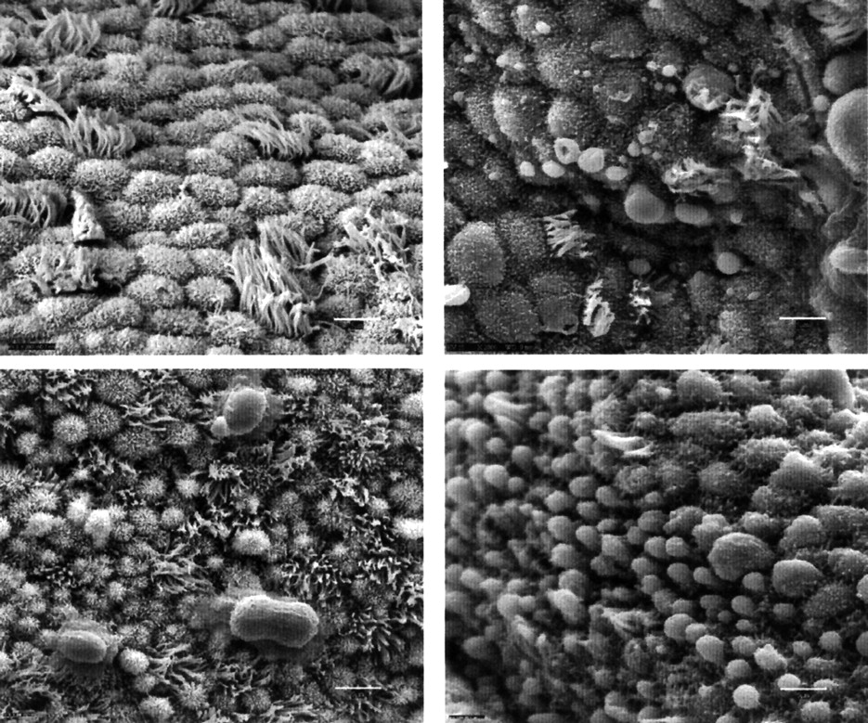

Slide 20
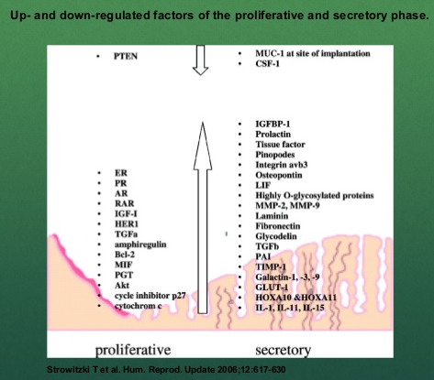

Slide 21
ENDOMETRİAL RESEPTİVİTEYİ ETKİLEYEN GENETİK FAKTÖRLER
Uterine sensitization-associated gene-1 (USAG-1),

Slide 22
ENDOMETRİAL RESEPTİVİTEYİ ETKİLEYEN GENETİK FAKTÖRLER
Endometrial bleeding associated factor (EBAF)
found to be expressed in the late secretory and menstrual phase of the endometrium.

Slide 23
ENDOMETRİAL RESEPTİVİTEYİ ETKİLEYEN HORMONLAR
COH ESNASINDAKİ YÜKSEK ESTROGEN RESEPTİVİTEYİ KÖTÜ ETKİLER

Slide 24
ENDOMETRİAL RESEPTİVİTEYİ ETKİLEYEN HORMONLAR
Estrogen and progesterone
At 527 cycles in subfertile patients, it was
found that significantly more viable pregnancies
occurred among patients with an estrogen to
progesterone ratio in the range of 7.36 to 12.22
(calculated as estrogen in pmol/L divided by
progesterone in nmol/L).
Yang et al.

Slide 25
Gonadotropin Hormonlar
Periimplantasyon peryodunda LH reseptor sayısı ve LH tarafından işgalleri artar. Bu LH ın implantasyon ve desidualizasyonda önemini gösterir
Bonnamy et al.

Slide 26
GnRh agonist and GnRh antagonist
Agonist ve antagonist tedavilerden sonra düşük LH seviyesi gözlenir. Bu durum korpus luteum fonksion bozukluğu ve kısa luteal fazla beraberdir.
Tavaniotou A, Smitz J, Bourgain C, Devroey P. Ovulation
induction disrupts luteal phase function. Ann N Y Acad Sci
2001;943:55-63

Slide 27
GnRh agonist and GnRh antagonist
In GnRh-agonist cycles, mid-luteal biopsies has
revealed increased glandulo-stromal dyssynchrony
and delay in endometrial development, strong
positivity of endometrial glands for progesterone
receptors, decreased cell adhesion molecule profiles
with early appearance of pinopodes. These changes
suggest a shift forwards of implantation window.
Progesterone supplementation improves endometrial
histology, and its necessity has been established, at
least in cycles, using GnRh agonists
Soliman S, Daya S, Graham RA, Seif MW, Cook ID. The
role of luteal phase support in infertility treatment: a metaanalysis
of randomized trials. Fertil Steril 1994;61:1068-76

Slide 28
YAŞIN ENDOMETRİAL RESEPTİVİTEYE TESİRİ
There is significant decline in human fecundity
with advancing age. A significant decrement in
success rate is also seen in older women
undergoing assisted reproduction, including invitro
fertilization . Rosenwaks et al., have
observed a drop in the ongoing pregnancy rate per
ET, from 48.8% in women aged < 30 years to
13.6% in women aged < 42 years. Embryo
implantation rates also decline in a linear fashion,
from 29% in women < 34 years to approximately
5% at age 42. Borini et al., found reduced
pregnancy rates in patients over the age of 40.

Slide 29
YAŞIN ENDOMETRİAL RESEPTİVİTEYE TESİRİ
The abnormal endometrial receptivity in aging subjects may be due to decreased levels of progesterone receptors promoted by the low levels of E2 receptors. However, when the progesterone dosage for luteal support was increased, recipients aged over 40 years had a marked increase in pregnancy rate when compared with younger patients.

Slide 30
YAŞIN ENDOMETRİAL RESEPTİVİTEYE TESİRİ
Oosit tükenmesi endometrial reseptiviteyi de bozar. Donor oosit çalışmalarında bu gösterilmiştir.
Navot D, Bergh PA, Williams AM, John Garrisi G, Guzman
I, Sandler B, Rabinowitz R, Birkenfeld A. Poor oocyte
quality rather than implantation failure as a cause of agerelated
decline in female fertility. Lancet 1991;337:1375-7

Slide 31
ENDOMETRİAL RESEPTİVİTENİN POTANSİEL MARKERLARI
PROLİFERASYON,DİFERANSİASYON VE SEKRESYON GİBİ BİRÇOK HÜCRE FONKSİONU GROWTH FAKTÖRLER VE SİTOKİNLER TARAFINDAN YÖNETİLİR

Slide 32
Endometrial adhesion molekulleri
4 Ana grup:
integrins,
cadherins,
selectins
immunoglobulin
Springer TA. Adhesion receptors of the immune system.
Nature 1990;346:425-34.

Slide 33
Endometrial adhesion molecules
Integrins are cell adhesion molecules involved in cell-cell and cell-matrix interactions and contributing to cell migration and signal
transduction . Integrins are a family of
transmembrane glycoproteins that act as a receptor
for extracellular matrix ligand, osteopontin (OPN).
Three integrins are expressed by the endometrium
with a pattern that coincides well with the window
of implantation: α1β1, α4β1, and αvβ3 are
coexpressed on glandular epithelium only during
cycle days 20 to 24 corresponding the putative
window of implantation. They have been proposed
as the best of the immunohistochemical markers of
endometrial receptivity during implantation window
. Lessey BA. Endometrial integrins and the establishment of
uterine receptivity. Hum Reprod 1998;13:247-61

Slide 34
RESEPTİVİTE BOZULMASINDA
Düşenler
Failure of appearance of a specific integrin – V 3 in the endometrium at the time of implantation was suggested as a cause of implantation failure (Tei et al., 2003 ; Thomas et al., 2003 ).
Yükselenler
High levels of aromatase p450 mRNA (Brosens et al., 2004 ), changes in pinopode expression (Pantos et al., 2004 ) and high matrix metalloproteinases (Inagaki et al., 2003 ) have been suggested to be associated with RIF.

Slide 35
Endometrial adhesion molekulleri
Mid-luteal integrinler naturale gore indukte sikluslarda dusuk bulunurlar buna "type I defect`` denir. Bu hastalarin cogu progesteronla tedavide hem endometrial histoloji hemde αv β3 integrinde duzelme olur
Histolojik olarak normal ama αv β3
Integrin eksik olursa "type II defect", denir

Slide 36
Vß3 integrin expression is orchestrated
in the human endometrium
positive [e.g. epidermal growth factor (EGF), heparin-binding EGF (HB-EGF)] and
negative [e.g. 17ß-estradiol (E₂)] factors (Somkuti et al., 1997 ).
During the proliferative phase, high estrogen levels act via the estrogen receptor- (ER ) to inhibit integrin expression. The luteal progesterone rise subsequently down-regulates the number of those receptors, thus indirectly suppressing the inhibitory effects of E₂ on integrins. This results in a net integrin increase. Progesterone, probably, also acts positively by increasing paracrine stromal factors (e.g. EGF and HB-EGF) to induce epithelial ß3 integrin expression that serves as the rate-limiting step in Vß3 formation (Lessey, 2003 )

Slide 37
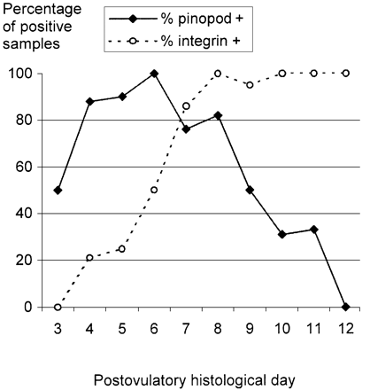

Slide 38
Aberrant Vß3 integrin expression pattern has been associated with
unexplained infertility (Klentzeris et al., 1993 ; Lessey et al., 1995 ; Tei et al., 2003 ),
endometriosis (Lessey et al., 1994b ),
hydrosalpinx (Meyer et al., 1997 ),
luteal phase deficiency (LPD; Lessey et al., 1992 ) and, more recently,
polycystic ovarian syndrome (PCOS; Apparao et al., 2002 ). Other investigators could not, however, demonstrate different integrin pattern in endometriosis (Creus et al., 1998 ).

Slide 39
Endometrial anti-adhesion molecules
As the attaching embryo approaches the
luminal epithelial surface of the uterus, it
encounters a mucinous layer, the glycocalyx .
The mucins in this layer are a group of antiadhesive
molecules, the most important of which is
mucin 1(MUC-1). Mucins are a family of
glycoprotein present on the surface of human
epithelial cells. In human its expression is high
during periimplantation period . It is possible that
the high periimplantation levels of MUC1 could play
a role in "shielding" the implanting blastocyst from
other inhibitory factors on the epithelial surface.
Tabibzadeh S. Molecular control of the implantation
window. Hum Reprod Update 1998;4:465-71

Slide 40
Human embryo implantation in the uterus. (A) Endometrium proliferates under estrogen enhancement. (B) Progesterone from luteinized follicles leads to endometrial differentiation. (C) The blastocyst enters the uterus through the ostia and rolls freely over the endometrium under signals by L-selectin. (D) Mucin-1 (MUC-1) repels the blastocyst and prevents its adhesion to endometrial areas with poor chances of implantation. (E) Chemokines and cytokines attract the blastocyst to the optimal implantation spot. (F) Adhesion molecules (e.g. integrins and cadherins) firmly attach the blastocyst to the endometrial pinopods to ensure further successful implantation.

Slide 41
Endometrial anti-adhesion molecules
Alternatively, it could carry a specific recognition
structure for the embryo. In women who suffer recurrent miscarriage there is evidence for reduced levels of MUC1 suggesting that these molecules play a significant role in the establishment and maintenance of early pregnancy .

Slide 42
Endometrial cytokines
Although many
cytokines may play a part in implantation, a vital role has been clarified in four namely: Leukaemia inhibitory factor, interleukin-1, interleukin-11 and colony-stimulating factor . Leukaemia
inhibitory factor (LIF) is produced by the receptive
phase endometrium . Danielsson et al.
showed reduced immunostaining for LIF after
treatment with the antiprogestin, mifepristone.
These circumstantial evidences suggest that LIF
plays a role in endometrial receptivity, but its exact
role is currently unclear.
Sharkey A. Cytokines and implantation. Rev Reprod
1998;3:52-61

Slide 43
Endometrial pinopods’ development is associated with the mid-luteal phase increased expression of
leukaemia inhibitory factor (LIF) and its receptor (Aghajanova et al., 2003 ), progesterone (Stavreus-Evers et al., 2001 ) and integrin Vß3 (Lessey et al., 1992 ). The detection of pinopods during the mid-secretory phase may be extremely useful for the assessment of endometrial receptivity to optimize implantation rates.

Slide 44
Endometrial growth factors
a. Heparin binding-epidermal growth factor (HBEGF)
was expressed during the time of maximal
endometrial receptivity . Based on recent
studies, it is tempting to think that HB-EGF
maintains a role in both adhesion and development
in the embryo
b. Insulin like growth factor binding protein-
1(IGFBP-1) is a major product of secretory
endometrium and decidua. It inhibits the action of
IGF at their target cells. Its role in endometrial
receptivity awaits further investigation.
Tamada H, Higashiyama C, Takano H, Cohen J, Massey JB,
Robinson J, Killick SR. The effects of heparin-binding
epidermal growth factor-like growth factor on
preimplantation-embryo development and implantation in
the rat. Life Sci 1999;64:1967-73

Slide 45
Endometrial immune markers
The endometrium has a large population of
lympho-myeloid cells that undoubtedly play a
variety of roles in the implantation process. It
has been reported that women with unexplained
infertility have significant lower levels of
endometrial CD8+ (T suppressor/cytotoxic) and
CD56+ (natural killer) cells, and higher levels of
CD4+ (T helper/inducer) cells, than fertile control
Klentzeris LD, Bulmer JN, Warren MA, Morrision L, Li
TC, Cooke ID. Lymphoid tissue in the endometrium of
women with unexplaned infertility: Morphometric and
Immunohistochemical Aspects. Hum Reprod 1994;9:646

Slide 46
Mouse Ascites Golgi (MAG)
The MAG test, done during an
endometrial biopsy measures sticky mucinous
substances secreted by endometrial glands before
implantation and is considered as an endometrial
function test (EFT). Over 85% of the
endometrial biopsies from normal, fertile women
express higher levels of MAG between days 5 and
18 of the menstrual cycle with no expression after
day 19.
kliman H, Feinberg R, Schwartz L, Feinman M, Laui E,
Meawough E. A mucin like glycoprotein identified by MAG
(mouse ascites Golgi) antibodies. Menstrual cycle dependent
localization in human endometrium. Am J Pathol
1995;146:166-81.

Slide 47
Dubowy et al, developed an EFT
based on the endometrial expression of cyclin E
and p27 . This test allows dating of the
endometrium and differentiating between normally
and abnormally developing endometrium. Cyclin E
progressed from the basal to the lateral cytoplasm
(midproliferative phase) to the nuclus (day 18 to
19) and was absent in biopsies after day 20. First
appearing on days 17 to 19, p27 was found only in
the nuclei.
DuboyL, Feinberg F, Keefe D et al. Improved endometrial
assessment using cyclin E and p27. Fertil Steril
2003;80:146-56.

Slide 48
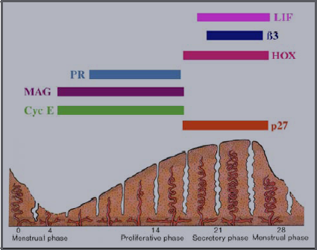

Slide 49
Matrix Proteinler
Laminin,
fibronectin ,
collagen IV are found in secretory endometrium but are absent in the
endometrium of patients with unexplained
infertility . These suggest that these matrix
proteins are likely to be required for implantation.
Bilalis D, Klentzeris L, Fleming S. Immunohistochemical
localization of extracellular matrix proteins in luteal phase
endometrium of fertile and infertile patients. Hum Reprod
1996;11;271-18

Slide 50
Another endometrial protein, glycodelin, has a proposed immunomodulatory role during
implantation. This protein is present in the
endometrium under the control of progesterone and
antiprogestins
Muller M, Vinge J, Vaisse C, Taylor R. Glycodelin: a pane
in the implantation window. Semin Reprod Med
2000;18:289-98.

Slide 51
Human embryo implantation in the uterus. (A) Endometrium proliferates under estrogen enhancement. (B) Progesterone from luteinized follicles leads to endometrial differentiation. (C) The blastocyst enters the uterus through the ostia and rolls freely over the endometrium under signals by L-selectin. (D) Mucin-1 (MUC-1) repels the blastocyst and prevents its adhesion to endometrial areas with poor chances of implantation. (E) Chemokines and cytokines attract the blastocyst to the optimal implantation spot. (F) Adhesion molecules (e.g. integrins and cadherins) firmly attach the blastocyst to the endometrial pinopods to ensure further successful implantation.

Slide 52
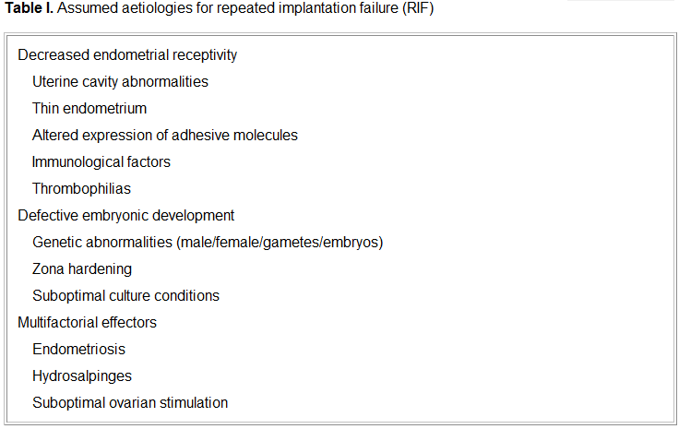

Slide 53
Morphological Markers

Slide 54
Pinopodes
The endometrium undergoes a well-established
series of histological and ultrastructural changes under the influence of estrogen and progesterone
during the menstrual cycle . Morphological
changes include characteristic histological
transformations, such as reduced mitotic activity,
glandular secretion, and stromal edema, that are
often accompanied by the presence of globular
protrusions in the surface membrane of epithelial
cells, named pinopodes .
70. Noyes RW, Hertig and Rock J. Dating the endometrial
biopsy. Fertil Steril 1950;1: 3-25
71. Sarantis L, Roche D, and Psychoyos A. Displacement of
receptivity for nidation in the rat by the progesterone
antagonist RU 486: a scanning electron microscopy study.
Hum Reprod 1988;3:251-5

Slide 55
Apoptosis
Apoptosis is a usual phenomenon throughout
the menstrual cycle, peaking at menses, but locally
regulated apoptosis is also vital for successful
implantation. Recent evidence suggests that
regulated apoptosis is important during the window
of receptivity . On days 19-20, apoptosis is
detectable in the glands of the basal layer,
subsequently extending to the functional layer. The
significance of this finding in relation to opening
of the implantation window is under investigation.
Galan A, O'Connor E, Valbuena D, Herrer R, Remohi J. The
human blastocyst regulates endometrial epithelial apoptosis
in embryonic adhesion. Biol Reprod 2000;63:430-9.

Slide 56
ASSESSMENT OF
ENDOMETRIAL RECEPTIVITY
A good correlation between endometrial
thickness and the prevalence of conception has
been found . On the other hand other
studies do not support this view .
However, a very thin endometrium (<7mm)
seems to be accepted as a reliable sign of
suboptimal implantation potential .
Implantation and pregnancy rates are
significantly reduced if the endometrial
thickness is increased (>14 mm) . This
finding was not proved by other authors
Endometrial thickness has a significant positive
spontaneous and stimulated cycles. Hum Reprod 1990;5:377
. Leibovitz Z, Grinin V, Rabia R, Degani S, Shapiro I, Tal J,
Eibschitz I, Harari O, Paltieli Y, Aharoni A, Zeevi J, Ohel G.
Assessment of endometrial receptivity for gestation in
patients undergoing in vitro fertilization, using endometrial
thickness and the endometrium-myometrium relative
echogenicity coefficient. Ultrasound Obstet Gynecol
1999;143:194-9Elnashar A, Afifi A, Donia O. Endometrial thickness and
pregnancy rates in infertile couples undergoing AIH. Benha
M J 1995;12:1-9.

Slide 57
ASSESSMENT OF
ENDOMETRIAL RECEPTIVITY
It was found that the multilayered echogenic
pattern, the so-called triple line appearance, was predictive of pregnancy. However,
pregnancies can occur in absence of this
pattern, albeit at a lower frequency.
Failure to establish a homogenous
hyperechogenic pattern by the midluteal phase
is associated with lower pregnancy rates .

Slide 58
ASSESSMENT OF
ENDOMETRIAL RECEPTIVITY
Uterine artery Doppler measurements are not representative of
endometrial receptivity since they are based on
flow to the entire uterus. Also spiral artery Doppler
pulsatility index failed to predict implantation.

Slide 59
ASSESSMENT OF
ENDOMETRIAL RECEPTIVITY
Raga et al. performed three-dimensional
volumetry of the endometrum at the time of ET to
assess its value in predicting endometrial
receptivity. The investigator found that a minimum
volume of 2ml was a prerequisite for a receptive
endometrium and that no pregnancy was achieved
when endometrial volume measured <1ml. Beyond
endometrial volume of 2ml, no relationship was
apparent in terms of endometrial receptivity
increasing if endometrial volume increased from 2-
4 ml to > 4 ml.

Slide 60
ASSESSMENT OF
ENDOMETRIAL RECEPTIVITY
Kupesic et al. performed
three-dimensional power Doppler ultrasonography
of the endometrium on the day of embryo transfer,
they concluded that endometrial thickness and
volume, endometrial morphology and subendometrial perfusion can not predict endometrial receptivity. Use of subendometrial vascularization index was superior in predicting the pregnancy rate
of IVF to using endometrial volume .

Slide 61
STRATEGIES FOR IMPROVING
ENDOMETRIAL RECEPTIVITY
To develop ovarian stimulation protocols that
cause a minimum reduction in endometrial
receptivity or may even increase it.
Improving endometrial receptivity by
decreasing estradiol levels, during the
preimplantation period in high responders, with
use of FSH step-down regimen. Controlled ovarian
hyperstimulation is associated with
supraphysiologic hormone levels compared with
natural cycles . High E2 levels, which are
known to be interceptive and altered
E2/progesterone ratios which are also associated
with impairment of endometrial receptivity, are the
main factors affecting receptivity in high
responders

Slide 62
STRATEGIES FOR IMPROVING
ENDOMETRIAL RECEPTIVITY
The early luteal phase of cycles undergoing
controlled ovarian hyperstimulation is
characterized by markedly elevated serum
progesterone levels during the periovulatory
period, advanced endometrial histological features,
and an absence of endometrial pinopodes at the
time of embryo implantation. Early progesterone
rise has a negative impact on endometrial
receptivity, but not on oocyte-embryo quality
. These cause premature endometrial
luteinization and premature appearance of
implantation window,

Slide 63
STRATEGIES FOR IMPROVING
ENDOMETRIAL RECEPTIVITY
To improve uterine vascularization:
1. Low dose aspirin
2. L-arginine (Nitric oxide donor): L-arginine
supplementation improves the uterine blood flow, endometrial receptivity, implantation

Slide 64
STRATEGIES FOR IMPROVING
ENDOMETRIAL RECEPTIVITY
To treat the pathological conditions:
1. Luteal phase defect:
2. Fibroids distorting the uterine cavity
3. Intrauterine adhesions:
4. Uterine septum:
5. Hydrosalpinx
6. Endometriosis
7. Autoimmune conditions: Women with unexplained recurrent
abortion and infertile women in whom multiple
attempts at embryo transfer have failed, show
elevated levels of peripheral and endometrial
CD56+ CD16+NK-cells.

Slide 65
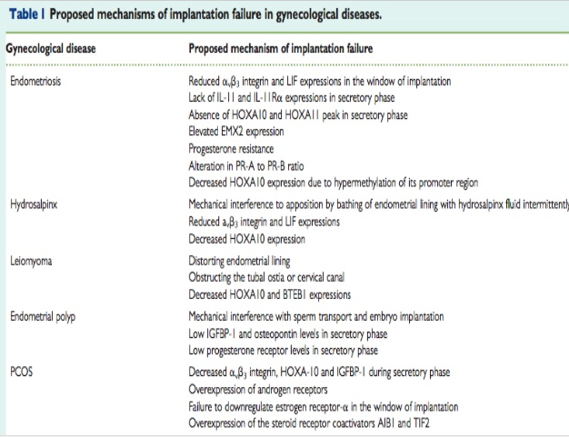

Slide 66
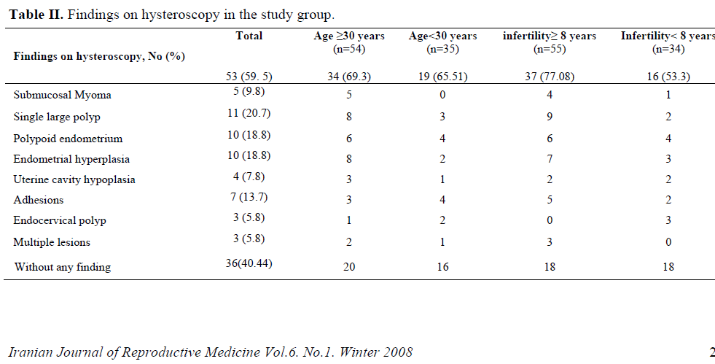

Slide 67
Anatomic abnormalities are lesions inside the uterus that mechanically inhibit implantation. These anatomic abnormalities act like an intrauterine device to prevent implantation of the embryo

Slide 68
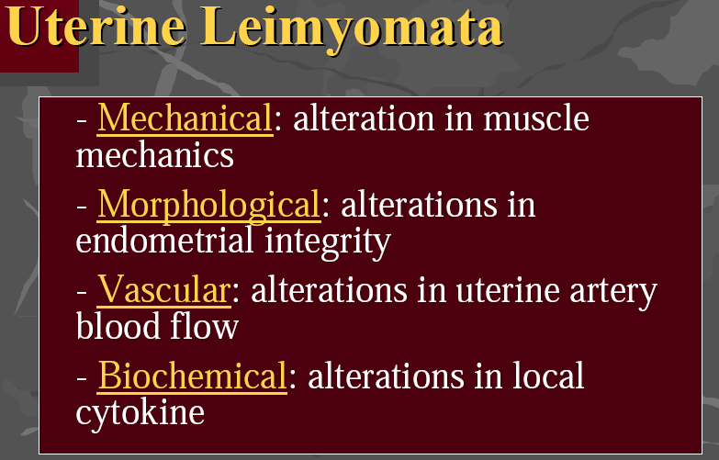

Slide 69
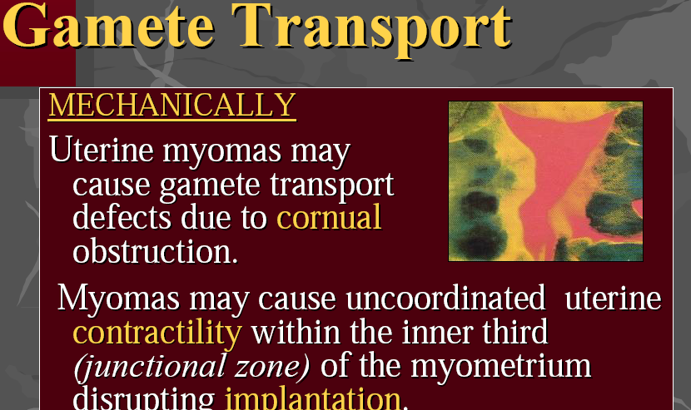

Slide 70
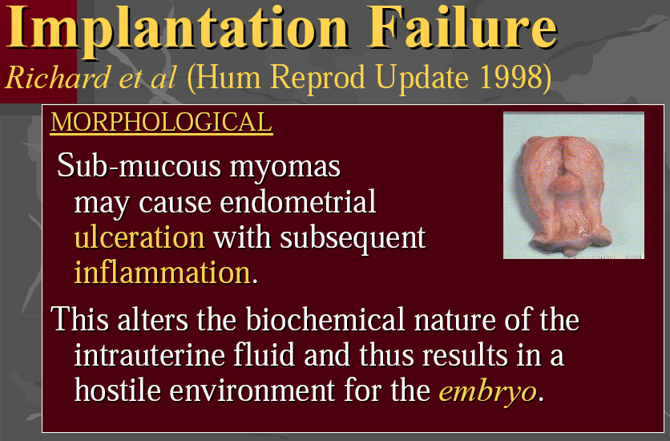

Slide 71
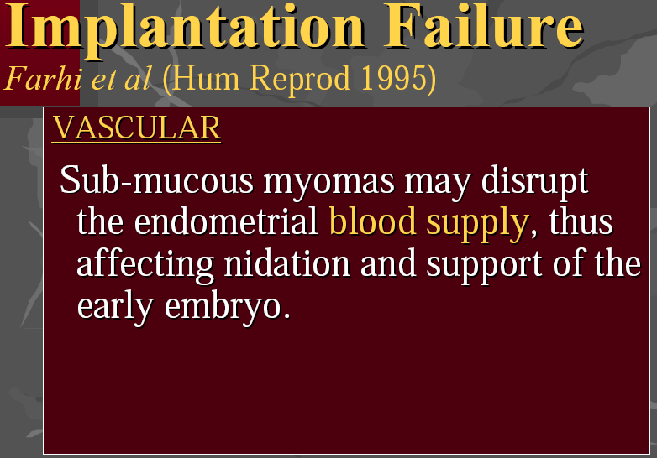

Slide 72
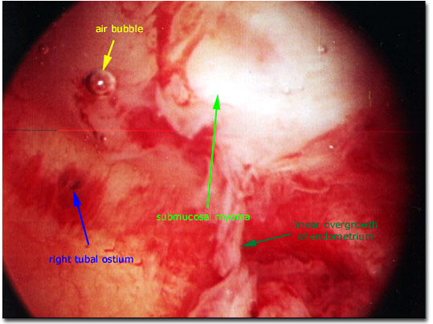
SUBMÜKÖZ MYOM

Slide 73
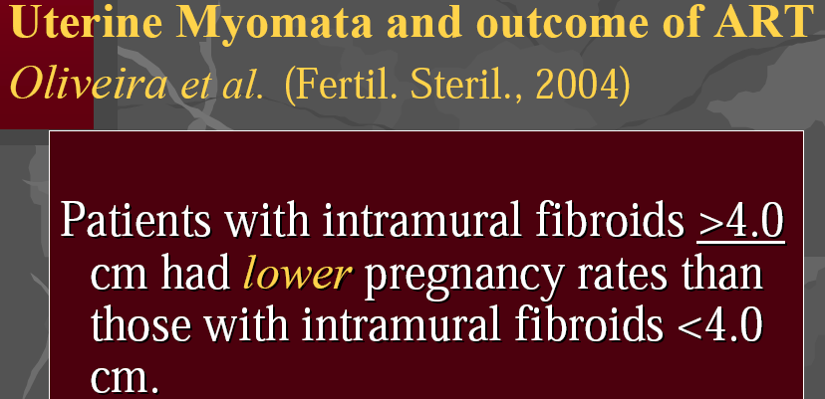

Slide 74
Myomectomy
The favourable PRs obtained after myomectomy lead many clinicians to believe that removal of myomas increases pregnancy and live-birth rates (review Donnez and Jadoul, 2002 ). However, no appropriate prospective studies have been performed. Furthermore, no information on the value and complications of myomectomy in RIF is available, although most clinicians recommend hysteroscopic removal of submucous fibroids distorting the uterine cavity.

Slide 75
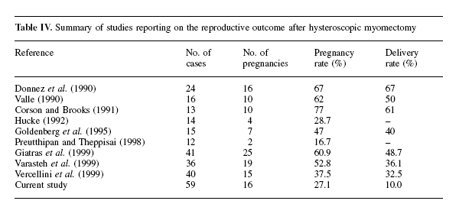
?

Slide 76
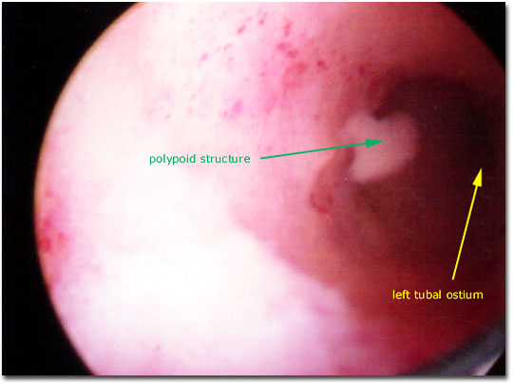
ENDOMETRİAL POLİP HS GÖRÜNTÜ

Slide 77
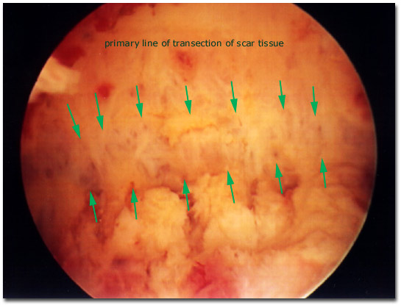
HİSTEROSKOPİK ASHERMAN GÖRÜNTÜ

